Slide 1

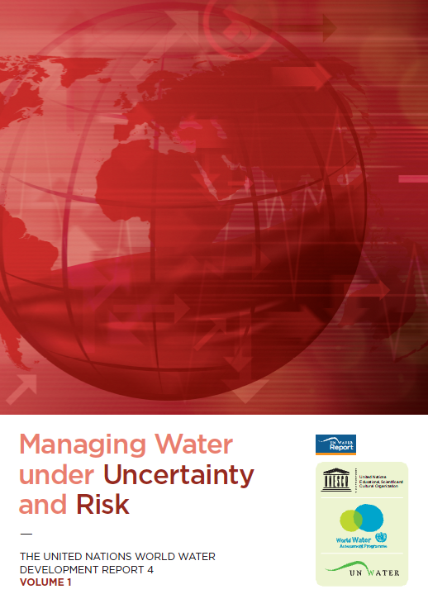
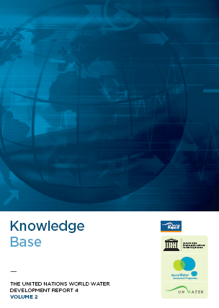
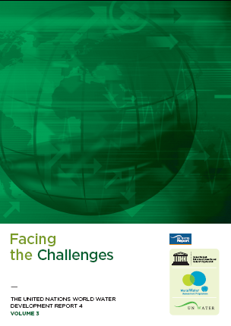
WWDR4
Managing Water under Uncertainty and Risk
Olcay Ünver, Coordinator,
UN World Water Assessment Programme

Slide 2
“Increasing demand and climate change threatening world water resources says new UN World Water Development Report” Feb 28, press
Unprecedented growth in demands for water are threatening all major development goals, warns the latest edition of the UN World Water Development Report, Managing Water under Uncertainty and Risk. It notes that rising food demand, rapid urbanization and climate change are significantly increasing pressure on global water supplies. This complex situation requires a radical rethink of the way water is managed.

Slide 3
Report estimates that the world will need 70 per cent more food by the middle of the century, with demand increasing especially for livestock products. A surge in food production will lead to an increase of at least 19 per cent in the water required for agriculture, which already accounts for 70 per cent of freshwater use.
Report warns that these figures could climb even higher if agricultural efficiency does not improve significantly.

Slide 4
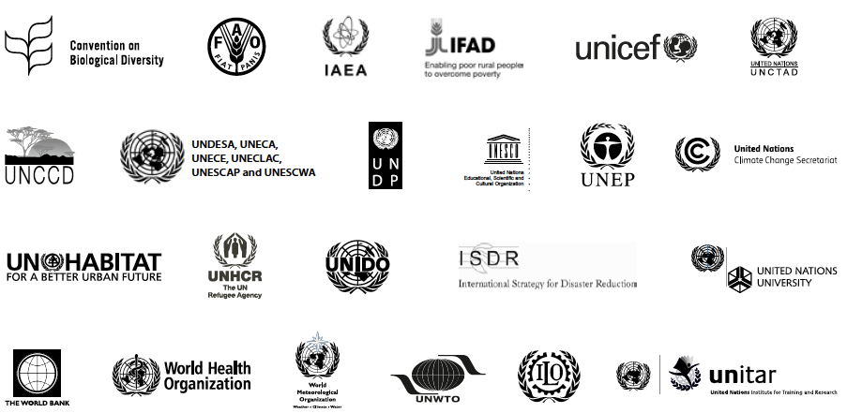
WWDR4 highlights the UN working as ONE
Notes:
The World Water Assessment Programme (WWAP), founded in 2000 and hosted by UNESCO, coordinates the production of the triennial UN World Water Development Report (WWDR), with an aim to report on the status of global freshwater resources and the progress achieved in reaching the Millennium Development Goals related to water . WWAP coordinates the input of 28 UN-Water members and its partners to the World Water Development Report (WWDR).
UN’s flagship report on water resources;

Slide 5

WWDR4 audience
Recent UN-Water survey shows that the WWDR is
used extensively for:
- self learning, - educational support,
- advocacy and policy development ,
- drawing on the lessons learned presented
in the report
Notes:
The report minimizes the use of technical jargon and so that it can be read and understood by a general audience.
Initial findings of an on-going survey on UN-Water publications show that, in addition to advocacy and policy development, the WWDR is used extensively for educational support and for drawing on the lessons learned which are presented in the report. We have therefore taken to necessary steps to ensure that the messages appearing in the Report and in accompanying materials are as accessible as possible; we are committed to getting the messages out through a variety of communication pathways, including the media.

Slide 6
WHAT IS NEW in WWDR4?
Comprehensive scope: 17 areas/topics/sectors
New regional component
Holistic within and outside the water box
Glimpses into possible futures
Gender-mainstreamed
Thematic focus: ‘Managing water under uncertainty and risk’
Notes:
The first two editions of the WWDR provided comprehensive assessment of the issues, trends and developments affecting and related to water on the basis of different ‘challenge areas’. Under the coordination of leading UN agencies, these challenge areas were presented as individual chapters that described the state of the resource and ecosystems; major use sectors (human health, food and agriculture, industry, energy, human settlements); and management challenges (managing risks, sharing water, valuing water, enhancing knowledge and capacity, governance).
The third WWDR took a different approach (and structure) by providing a holistic analysis of the water domain while recognizing the externalities and their role on the state, use and management of the earth’s water resources. It introduced the concept of external forces, providing a general description of the main ‘drivers’ of change and how these ultimately affected demand for – and thus had impacts on – freshwater resources
This fourth report builds on different elements of the first three editions and incorporates some entirely new aspects as well.
First, it reintroduces the twelve challenge area reports that provided the foundation for the first two editions. These were again prepared under the coordination of leading UN agencies. The challenge area reports focus on key challenges, recent developments and emerging trends, and on the external drivers and the pressures they place on water systems and how these can lead to a better understanding of uncertainty, management of risk and identification of opportunities. Water management and policy are illustrated through specific examples, ranging from adaptive design criteria for infrastructure or demand management to institutional capacity development and policies for different developmental sectors. Four new reports have been introduced, covering issues that had not been specifically covered under previous WWDRs: Water Quality, Groundwater, Gender, and Desertification, Land Degradation and Drought.
Second, in recognition that the global challenges of water can vary considerably across countries and regions, a series of five regional reports have been included, providing for the first time a regional focus to the WWDR4. These ‘regional reports’, which follow the same overall structure as the challenge area reports, were coordinated by the UN regional economic commissions.
Third, the Report delves into a deeper analysis of the drivers described in the third edition, and examines possibilities for their future evolution. This analysis is based on the results of the first phase of our World Water Scenarios Project. This is described in WWDR4 and will be the focus of several session and side-events here this week.
Fourth, this edition of the WWDR incorporates a theme, ‘Managing water under uncertainty and risk’, which serves as the overarching topic for the report. It examines current challenges to water resources, their use and management through the lens of uncertainty and risk. thus further building on the holistic approach taken in the WWDR3.
The report gives an account of the critical issues facing water’s challenge areas and different regions and incorporates a deeper analysis of the external forces (i.e. drivers) linked to water. It seeks to inform readers and raise awareness of the new threats arising from accelerated change and of the interconnected forces that create uncertainty and risk – ultimately emphasizing that these forces can be managed effectively and can even generate vital opportunities and benefits through innovative approaches to allocation, use and management of water

Slide 7
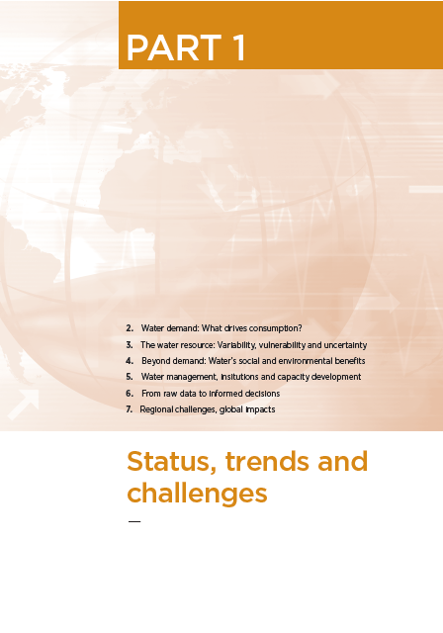
WWDR4 volume 1
  Overview of recent developments, emerging trends and key challenges w.r.t:
  - Demands
  - The Resource
  - Benefits
  - Management & Institutions
  - Data & Indicators
  The external forces driving these and the uncertainties and risks created by the drivers.
  Examination of these from a regional perspective.

Slide 8
Chapter 1: Recognizing the centrality of water and its global dimensions
• Water for irrigation and food production: one of the greatest pressures on freshwater resources (70% globally).
• Global population growth: 2–3 billion more people during next 40 years; changing diets lead to a predicted increase in food demand of 70% by 2050.
• Natural hazards: socioeconomic impacts occur through water. Damage representing 2–15% of annual GDP in developing countries.
• Water and Energy: of all energy produced globally, 7–8% is used to lift
groundwater, pump it through pipes, and to treat both groundwater and wastewater (can be as high as 40% in developed countries).

Slide 9
Chapter 1: Beyond the basin, the international and global dimensions
Climate Change: Investment needed to tackle a 2°C rise could range from billion US$70-100 per year between 2020 and 2050. Of this cost, billion US$14-19.2 is related to water, predominantly through water supply and flood management.
Transboundary Issues:
Surface water:148 states have international basins within their territory, and 21 countries lie entirely within them. 65% of the world’s 276 international river
basins lack any type of cooperative management framework.
Groundwater: About 2 billion people worldwide depend on groundwater supplies, which include 273 transboundary aquifer systems.

Slide 10
Chapter 1: Beyond the basin, the international and global dimensions
Meeting Food and Energy Demands: With population growth, by 2030, food demand is predicted to increase by 50% (70% by 2050) and energy demand by 60% over next 30 years. These issues are interconnected. Increasing agricultural output, for example, will substantially increase both water and energy consumption, leading to increased competition for water
between water-using sectors.
Biofuels are an increasingly prominent component of the energy mix. If by 2030 just 5% of road transport is powered by biofuels, this could amount to at least 20% of the water used for agriculture globally.

Slide 11
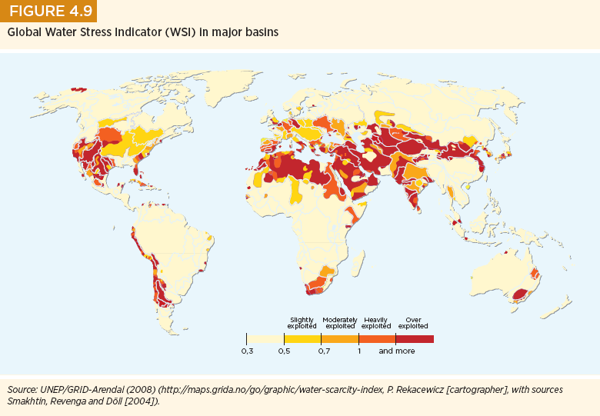
WWDR4

Slide 12
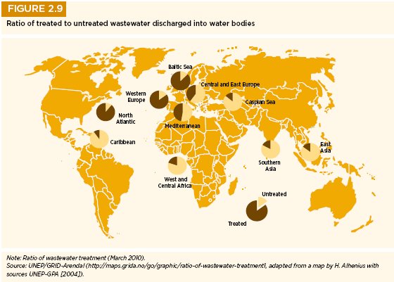
WWDR4

Slide 13
WWDR4

Slide 14
WWDR4

Slide 15
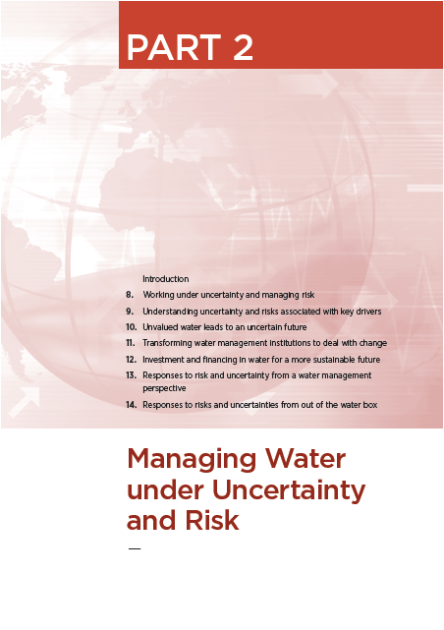
WWDR4
Part 2: ‘Managing water under uncertainty and risk’
The thematic part of the report in which issues are investigated through the lens of risk and uncertainty, with particular emphasis on climate change and other drivers of change.
Illustrations of how water managers and other decision-makers have responded to these challenges show the range of available options.

Slide 16
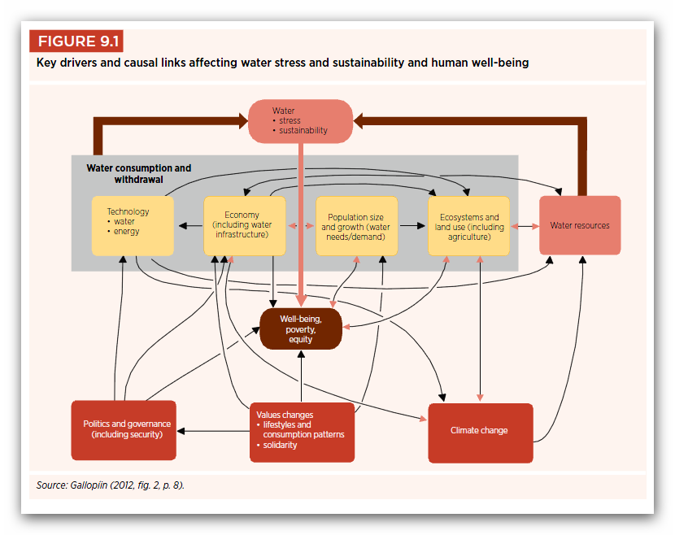
WWDR4

Slide 17
WWDR4
Chapter 13 – Responses to risk and uncertainty from a water management perspective
  Reducing uncertainty
  Reducing exposure and minimizing risks
  Living with uncertainty and risk: Trade-offs in water decision-making

Slide 18
Reducing uncertainty
Generating knowledge – Monitoring, Modeling and Forecasting: Integrated Water Resources Optimization Models
Adapting Planning: Examples of river basin flooding (e.g. UK’s ‘Making Space for Water’ program uses ecosystems instead of engineered infrastructure), urban flooding and dryland rehabilitation
Proactive Management: Farmer managed GW systems in Andra Pradesh, India.

Slide 19
Reducing exposure and minimizing risks
Environmental engineering:
Mangrove restoration in Vietnam to mitigate against coastal flooding (storms, sea-level rise)
Constructed wetlands for wastewater treatment in Bayawan City, Philippines
Investment in infrastructure (obvious but expensive)

Slide 20
Trade-offs in water decision-making
Ensuring reliable access to water for industrial purposes while providing a key pollution control service: Dow Chemical uses municipal household wastewater, which uses less energy to treat than the local brackish water in the area.

Slide 21
WWDR4
Chapter 14 – Responses to risks and uncertainties from out of the water box
  Reducing poverty and greening growth and economies
  Responding to climate change: adaptation and mitigation
  Business decisions to reduce risk and uncertainties
  Managing sectoral risks to generate benefits for water
  Mitigating risks and uncertainties

Slide 22
Responses to risks and uncertainties outside the water box
Reducing poverty and greening growth and economies
Cuba uses organic agriculture for sustainable growth (eliminating pesticides and chemical fertilizers allows the maintenance of high levels of water quality whilst generating direct health benefits)
Responding to climate change: adaptation and mitigation
Reducing Emissions from Deforestation and Forest Degradation (REDD) with water co-benefits

Slide 23
Business decisions to reduce risk and uncertainties
Restoring water provision in a dry area: Italcementi (illustrates how a business decision, initially motivated by profit and the need to access natural resources for production, has helped to reduce risks and uncertainties related to future water scarcity by providing an additional water reserve for communities and the environment)
Implicit valuation reduces business and water risks (Rio Tinto in Australia: creating a ‘valuation hierarchy’ for using different sources at different times – example of a ‘robust’ approach ensuring sustainability of both the resource and the business operation)

Slide 24
Responses to risks and uncertainties from out of the water box
Managing sectoral risks to generate benefits for water
Autovias’s Waterway Program decreased the need for road maintenance while helping to recharge one of Brazil’s most important aquifers (on a highway, water runoff/ collection programme reduces repair costs AND recharges aquifer)
Mitigating risks and uncertainties
The Caribbean Catastrophe Risk Insurance Facility (risk sharing: 16 participating small island countries pool their risks into one, diversified insurance portfolio)

Slide 25
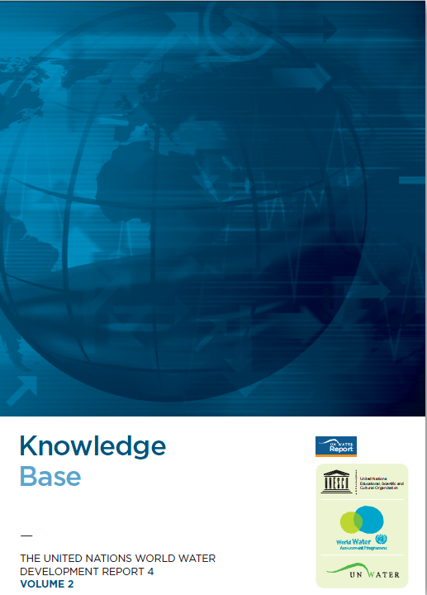
WWDR4 Volume 2
Part 3: Knowledge base
Comprehensive reports from challenges and regions
CHALLENGE AREA REPORTS
State of the Resource: Quantity and Quality
Human Settlements
Managing water along the livestock value chain
The global nexus of energy and water
Freshwater for industry
Ecosystems
Allocating water
Valuing water
Investing in water infrastructure, operation and maintenance
Water and institutional change
Developing knowledge and capacity
Water-related disasters
Desertification, land degradation and drought
REGIONAL REPORTS
Africa / Europe and North America / Asia and the Pacific / Latin America and the Caribbean / Arab region and Western Asia
SPECIAL REPORTS
Water and health / Water and gender / Groundwater
Notes:
Part 3, ‘Knowledge base’, contains the full challenge area reports prepared by UN-Water agencies and the regional reports prepared by the UN regional economic commissions – from which much of the material from Parts 1 and 2 was extracted – as well as the special reports I mentioned earlier. These are found in the second Volume of the Report.

Slide 26
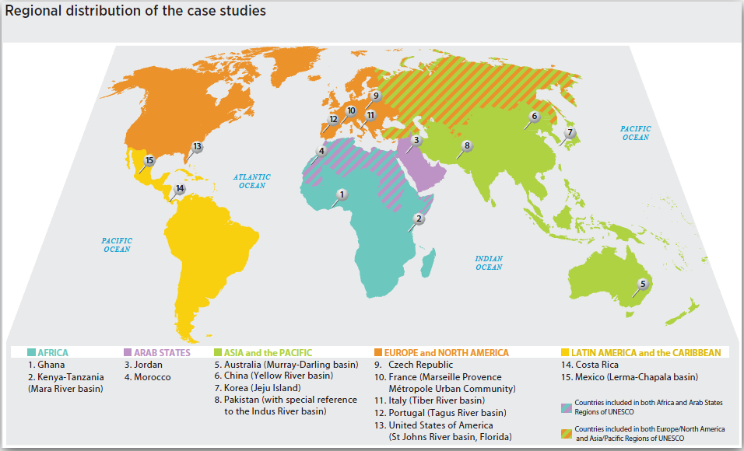
WWDR4 Volume 3
Volume 3 – Facing the Challenges (15 case studies at basin and national level)

Slide 27
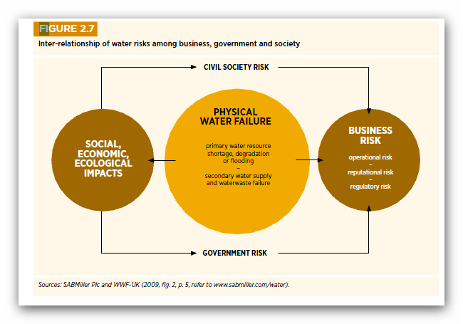
WWDR4 main messages: 1
The centrality of water
Water underpins all aspects of development: it is the only medium that links sectors and through which major crises can be jointly addressed.

Slide 28
WWDR4 main messages: 2
Increased coordination over water for meeting multiple goals
A coordinated approach to managing and allocating water across competing sectors to meet multiple goals also helps ensure that progress made in one sector is not offset by decline in others.
Notes:
A coordinated approach to managing and allocating water across competing sectors to meet multiple goals also helps ensure that progress made in one sector is not offset by declines in others.

Slide 29
WWDR4 main messages: 3
Flexible institutions, adaptive management
Strong institutions and political will are needed to facilitate discussion and decisions between sectors and help balance risks.
Notes:
Strong institutions and political will are needed to facilitate discussion and decisions between sectors and help balance risks. Institutional arrangements and regulatory frameworks must also have the flexibility to adapt to changing circumstances affecting water management.

Slide 30
WWDR4 main messages: 4
Global interdependencies with local impacts
Global interdependencies will increasingly be woven through water.
If no action is taken, to meet their needs regions and sectors without enough water will need to rely more heavily on others’ resources to meet them.
Notes:
Global interdependencies will increasingly be woven through water: If no action is taken, to meet their needs regions and sectors without enough water will need to rely more heavily on others’ resources to meet them.

Slide 31
WWDR4 main messages: 5
Concerted action and leadership from national governments
It is time for everyone to take concerted action!
Water managers
Leaders in government
Civil society
Business at local, basin, national and global levels
It is critical that national governments assume leadership and integrate water as a priority in all key policy areas within their own countries as well as through global policy tracks, such as the Millennium Development Goals, climate change talks and the Rio+20 process.
Notes:
Under global conditions of increasing uncertainty and risk, concerted action must now be taken by water managers, leaders in government, civil society and business at local, basin, national and global levels. It is critical that national governments assume leadership and integrate water as a priority in all key policy areas- trade and the economy, food and energy security, financing, public health and security - within their own countries as well as through global policy tracks, such as the Millennium Development Goals and the Rio +20 process.

Slide 32
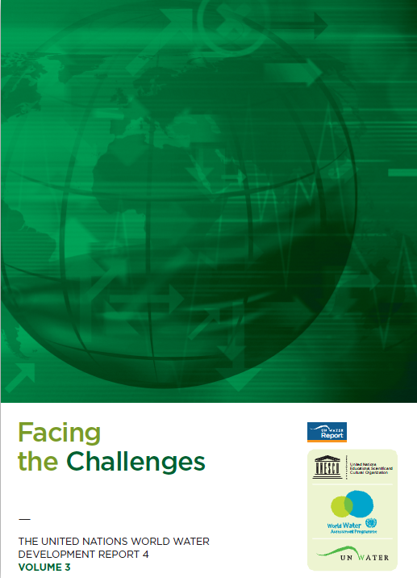
Thank you for your attention
Notes:
The WWDR4 is separated into four parts.
Part 1, ‘Status, trends and challenges’, provides an overview of recent developments, emerging trends and key challenges, including the external forces driving these and the uncertainties and risks created by the drivers. It also examines these from a regional perspective.
Part 2, ‘Managing water under uncertainty and risk’, is the thematic part of the report in which decisions affecting water, from management and institutions to allocation and financing, are investigated through the lens of risk and uncertainty, with particular emphasis on climate change and other drivers of change. Illustrations of how water managers and other decision-makers have responded to these challenges show the range of available options. They comprise the first Volume of the Report.
Part 3, ‘Knowledge base’, contains the full challenge area reports prepared by UN-Water agencies and the regional reports prepared by the UN regional economic commissions – from which much of the material from Parts 1 and 2 was extracted – as well as the special reports I mentioned earlier. These are found in the second Volume of the Report.

Slide 33
Farmer managed GW systems in Andra Pradesh, India
The Andhra Pradesh Farmers Ground Water Management System (APFAMGS) is a community-based project involving over 28,000 men and women farmers in 638 villages across 7 drought-prone districts.
A demand-side approach to the project allows farmers to manage their water resources, understand how groundwater systems operate, and make informed choices regarding their water use. The underlying premise of APFAMGS is that sustainable management of groundwater is feasible only if users understand its occurrence, cycle and limited availability, as well collective decision-making, which will govern the resource.

Slide 34
Constructed wetlands for wastewater treatment in Bayawan City
An artificial wetland was constructed to filter and transform nutrients and other constituents. The treated wastewater (97 % removal of BOD) was used initially for concrete production for construction. The effluent has almost ideal concentrations of nitrogen and phosphate to be used for ‘fertigation’ (to fertilise and irrigate). It is now used for an organic cut flower and vegetable farming project. Since November 2008 frequent and accurate analysis is conducted to analyse for faecal coliforms.
The investment in this constructed wetland infrastructure provides water resources for various economic activities, which would otherwise be compromised, thereby reducing uncertainty.

Slide 35
Dow chemical and city of Terneuzen
Dow’s Terneuzen manufacturing facilities in the Netherlands require a significant amount of freshwater. Since 2007, the site accepts more than 9.9 million litres of municipal household wastewater every day. Dow has been able to cut its freshwater use in half by using the wastewater from the municipality and also through recycling efforts. Not only does Dow save money on energy, but the municipality saves on treatment, which is done by Dow. This is a win-win approach. Trade-offs don’t need to be negative)

Slide 36
Cuba uses organic agriculture for sustainable growth
While ensuring national food security under a trade embargo, Cuba’s transition to organic agriculture has also had a positive impact on people’s livelihoods by guaranteeing a steady income for a significant proportion of the population. Moreover, the lack of pesticides for agricultural production is likely to have a positive long-term impact on Cubans’ well-being since such chemicals are often associated with various negative health implications such as certain forms of cancer.

Slide 37
Implicit valuation reduces business and water risks
Rio Tinto Aluminium’s Weipa bauxite-mining operations in Australia have multiple sources of water, each of which has its own associated costs and additional values. The four main sources are:
• Recycled or reused water from the tailings dam
• Site rainfall runoff
• Shallow aquifers underlying the area.
• The deeper aquifers of the Great Artesian Basin.
Availability of the different sources can vary during the year.
Rio Tinto identified the level of sensitivity of the shallow aquifers and the Great Artesian Basin during normal environmental risk management processes. This has been reinforced by engagement with key stakeholders, including the Great Artesian Basin Coordinating Committee and nongovernmental organizations.
These processes have aided the establishment of a formal hierarchy of sources, directing the operation to source first from tailings dams, then ‘slots’, then the shallow aquifers, and finally the Great Artesian Basin aquifers. The costs of these sources vary considerably. Instead of always using them in the order of cost increase, the establishment of the sourcing hierarchy effectively places an implicit value on the natural sources of water. In the case of the Great Artesian basin, the focus is on the long-term sustainability of the resource, as it has the slowest rate of recharge.

Slide 38
Autovias’s Waterway Program
Autovias built and manages 316.5 km of highways in Brazil’s São Paulo State. Including infrastructure construction could change the landscape, leading to erosion, settling, and decreased groundwater infiltration.
Autovias has developed a project that collects water on the highways’ surfaces and directs it towards the Guarani aquifer recharge zone. The company designed the program mainly to protect this vital water resource. Autovias earns no direct income from putting water into the aquifer, but the program helps decrease the need for road maintenance and prevents washouts, thus saving the company money.
Another win-win solution!

